Slide 1










Conference
Student Paper
Research Institutions
A Two-Phase Learning Approach for the Segmentation of Dermatological Wounds
Wellington Silva, Daniel Jasbick, Rodrigo Wilson, Paulo Azevedo-Marques, Agma Traina (speaker), Lucio Santos, Ana Jorge, Daniel de Oliveira, and Marcos Bedo
Institute of Mathematical and Computer Sciences - University of São Paulo
agma@icmc.usp.br
www.gbdi.icmc.usp.br
Funding Agencies
June/2019

Slide 2



Motivation
Motivation and Background
Proposed Method
Empirical Findings
Future Work
Photographs of ulcers in lower limb
Support dermatologists’ analyses
Tissue characterization
Non-intrusive process
Non-expensive: smartphone-based image recording
Non-expensive: digital photo management
A Two-Phase Learning Approach for the Segmentation of Dermatological Wounds

Slide 3
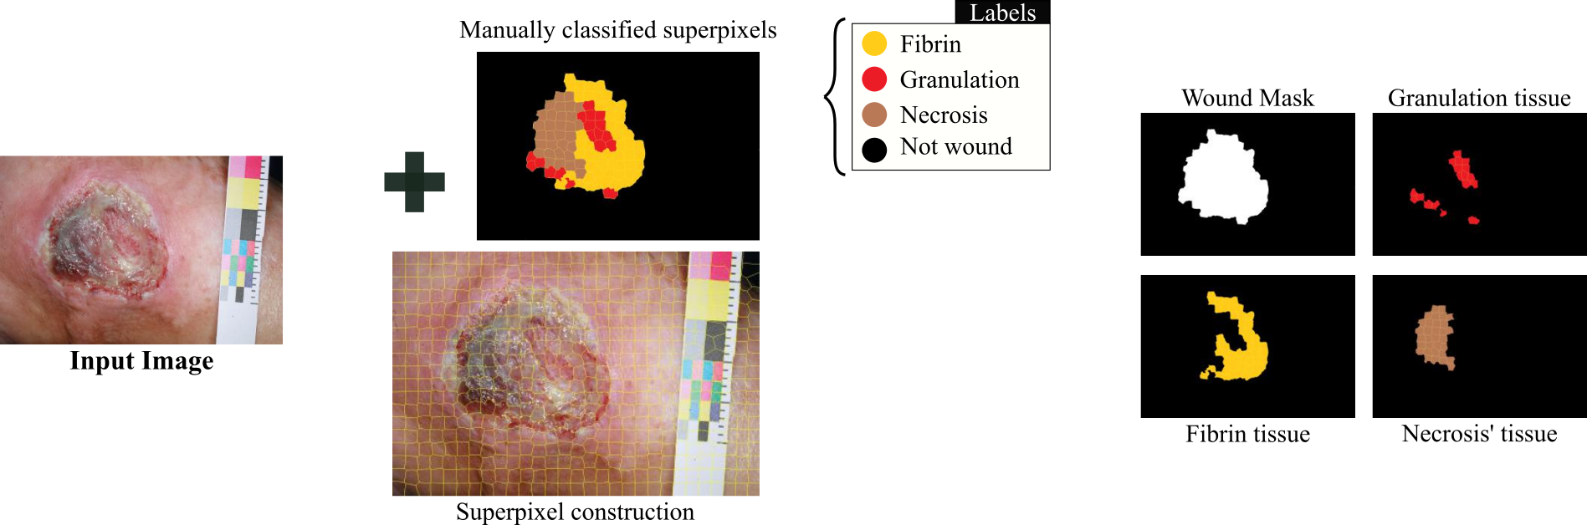
Motivation
Motivation and Background
Proposed Method
Empirical Findings
Future Work
Current approaches
Wound segmentation as a classification problem
Tissues of interest vs. non-interest
Building blocks: superpixels, feature extractor, training set, and classifier
A Two-Phase Learning Approach for the Segmentation of Dermatological Wounds

Slide 4
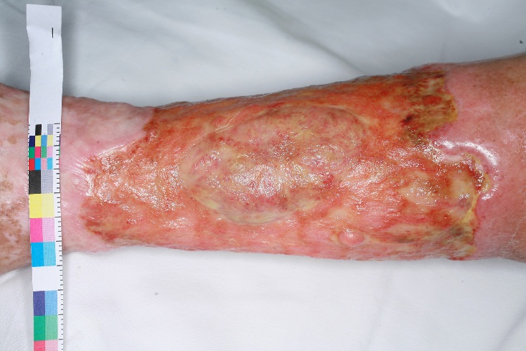
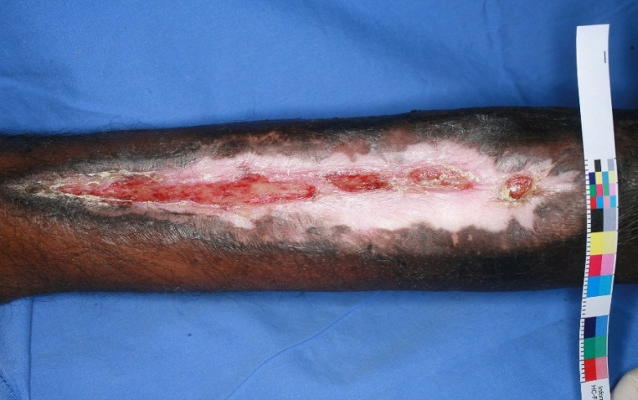
Open Issues...
Motivation and Background
Proposed Method
Empirical Findings
Future Work
Combination of wound tissues
Border and Reepithelization tissues
A Two-Phase Learning Approach for the Segmentation of Dermatological Wounds

Slide 5
Goals
Motivation and Background
Proposed Method
Empirical Findings
Future Work
Main Goal:
Designing a divide-and-conquer cluster approach for wound analysis
Processing Challenges
Potential groups
Background
removal
Wound “frontiers”
Health tissue
Mix of wound tissues
Border tissue
Diversified skin colors
Reepithelization
A Two-Phase Learning Approach for the Segmentation of Dermatological Wounds

Slide 6
Proposed Method - 2PLA
Motivation and Background
Proposed Method
Empirical Findings
Future Work
Overall idea = two phases:
Distinguish relevant and non-relevant image regions
Classification-based task (binary problem)
Smooth noise and misclassifications
Agglomerate remaining tissues by their similarity:
Split relevant regions into small pieces with well-defined borders
Represent such pieces as points of a multidimensional space
Calculate the distances between the points as a similarity score
Aggregate the similarities according to a clustering criteria
Result:
Object removal
Segmented wound, border and health tissues
A Two-Phase Learning Approach for the Segmentation of Dermatological Wounds

Slide 7
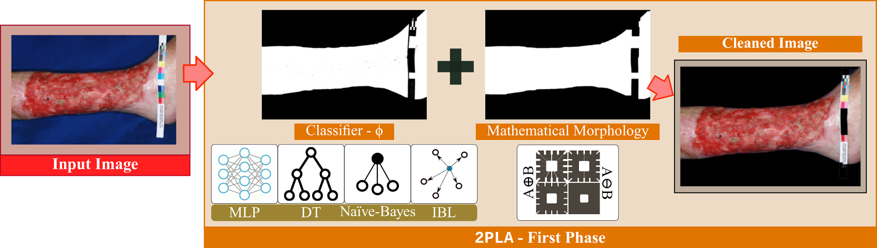
Proposed Method - 2PLA
Motivation and Background
Proposed Method
Empirical Findings
Future Work
A Two-Phase Learning Approach for the Segmentation of Dermatological Wounds

Slide 8
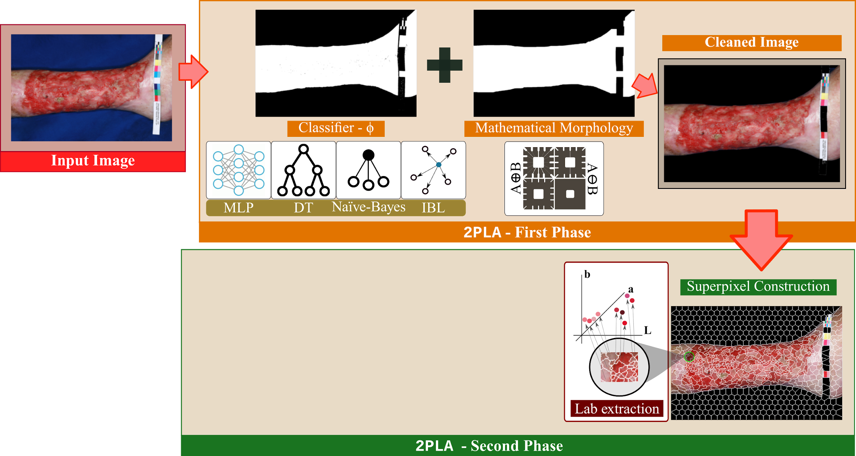
Proposed Method - 2PLA
Motivation and Background
Proposed Method
Empirical Findings
Future Work
A Two-Phase Learning Approach for the Segmentation of Dermatological Wounds

Slide 9
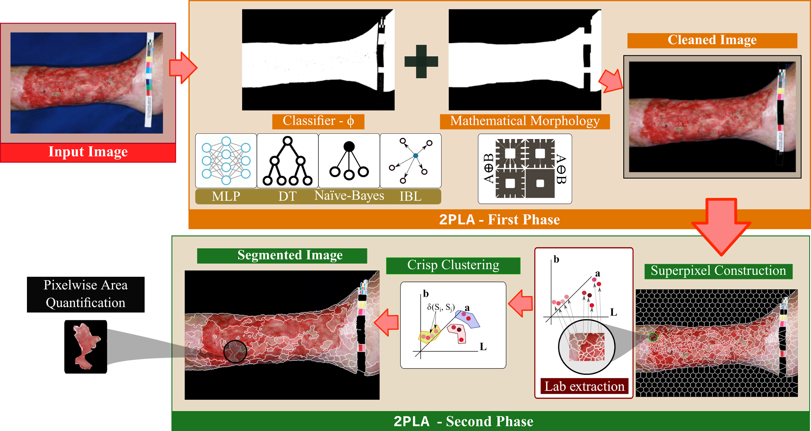
Proposed Method - 2PLA
Motivation and Background
Proposed Method
Empirical Findings
Future Work
A Two-Phase Learning Approach for the Segmentation of Dermatological Wounds

Slide 10
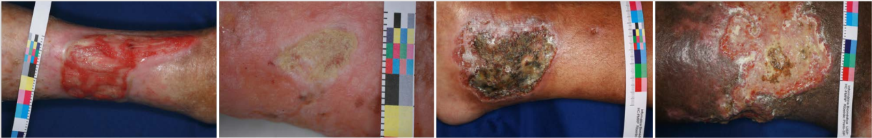
Dataset - ULCER_SET
Motivation and Background
Proposed Method
Empirical Findings
Future Work
Curated by Pereira et al. (2013)
Classification of color images of dermatological ulcers. Journal of Biomedicine and Health, 17(1):136–142.
217 photographies of venous and arterial ulcers in lower limbs
Independent patients with different skin colors, age, and treatments
Blue and white cloths were used to emphasize the contrast
Photos were taken with the same camera, angle and distance.
A Two-Phase Learning Approach for the Segmentation of Dermatological Wounds

Slide 11
2PLA - 1st Phase parameterization
Motivation and Background
Proposed Method
Empirical Findings
Future Work
We asked experts to provide a manual segmentation of 40 representative ULCER_SET images
Result:
Millions of pixels labeled as either “background” or “skin”
Skin pixels form border, granulation, fibrin, and necrosis areas
Training set:
Stratified sampling of labeled pixels in the RGB color space
Varying sizes: 1.10¹, 1.10², 1.10³, 1.10⁴, and 1.10⁵
Fed to 10-folds cross-validation routines
A Two-Phase Learning Approach for the Segmentation of Dermatological Wounds

Slide 12
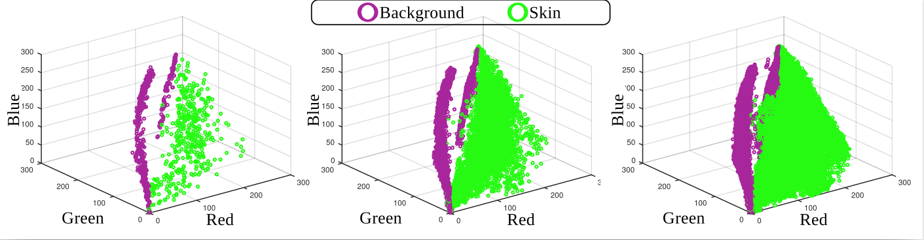
2PLA - 1st Phase parameterization
Motivation and Background
Proposed Method
Empirical Findings
Future Work
We asked experts to provide a manual segmentation of 40 representative ULCER_SET images
Result:
Millions of pixels labeled as either “background” or “skin”
Skin pixels form border, granulation, fibrin, and necrosis areas.
Training set:
Stratified sampling of labeled pixels in the RGB color space
Varying sizes: 1.10¹, 1.10², 1.10³, 1.10⁴, and 1.10⁵
Fed to 10-folds cross-validation routines
Sampling 1.10.³
Sampling 1.10.⁴
Sampling 1.10.⁵

Slide 13
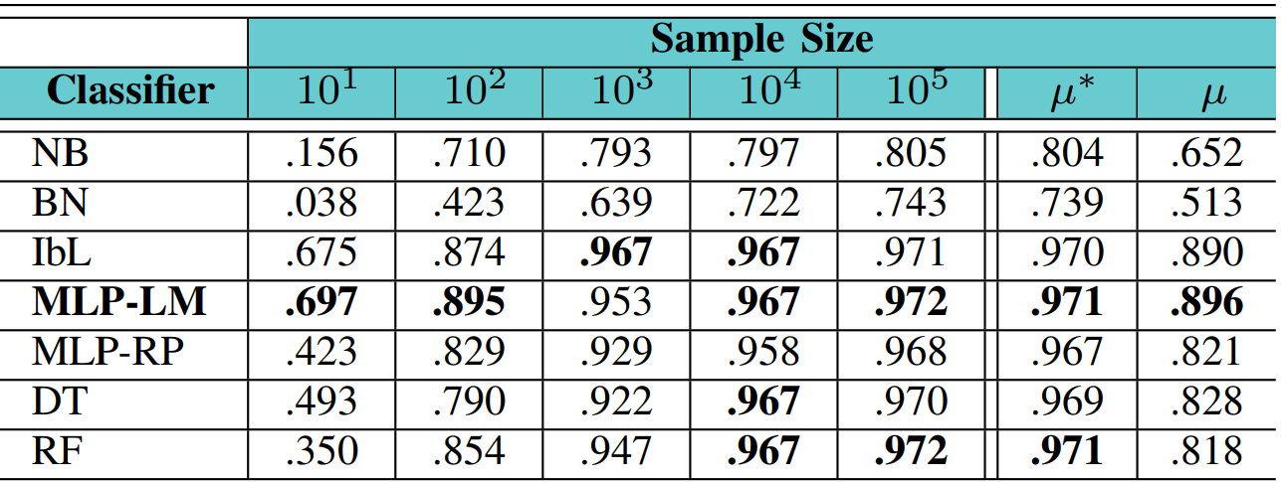
2PLA - 1st Phase parameterization
Motivation and Background
Proposed Method
Empirical Findings
Future Work
Finding the most suitable classifier
Training set sizes: 1.10¹, 1.10², 1.10³, 1.10⁴, and 1.10⁵
Average Cohen-Kappa Coefficient
Weighted Mean
Simple Mean
A Two-Phase Learning Approach for the Segmentation of Dermatological Wounds

Slide 14
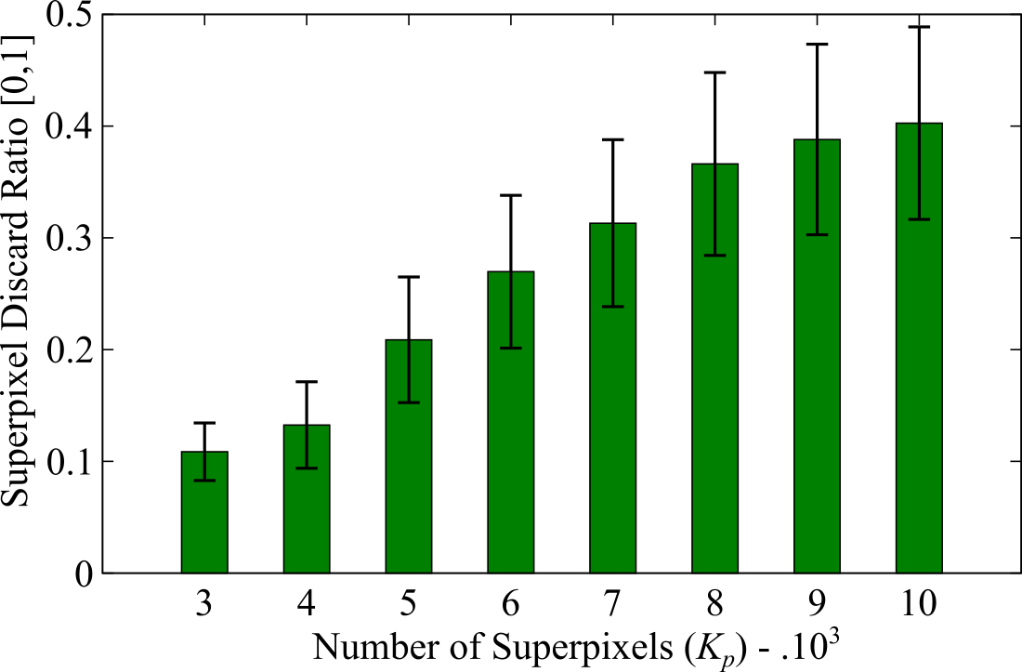
Discarding of Superpixels
Motivation and Background
Proposed Method
Empirical Findings
Future Work
Background removal - 40 images
Mean and deviation for the proportion of discarded regions
Discarding ratio grew linearly
Up to 48% dismissed regions
A Two-Phase Learning Approach for the Segmentation of Dermatological Wounds

Slide 15
2PLA - 2nd Phase parameterization
Motivation and Background
Proposed Method
Empirical Findings
Future Work
Superpixels of ULCER_SET images
Set as 550 to ULCER_SET as pointed out by Chino et al. (2018)
ICARUS: Retrieving Skin Ulcer Images through Bag-of-Signatures. In: CBMS, pp. 82-87
Feature Extractor
Average superpixel value in the LAB color space (3 dimensions)
Cluster Method: DBSCAN
Distance functions:
L₁, L₂, L∞, Canberra, and BrayCurtis
Similarity threshold ξ:
A varying percentage of maximum similarity ranging from 0.5% to 15%
A Two-Phase Learning Approach for the Segmentation of Dermatological Wounds

Slide 16
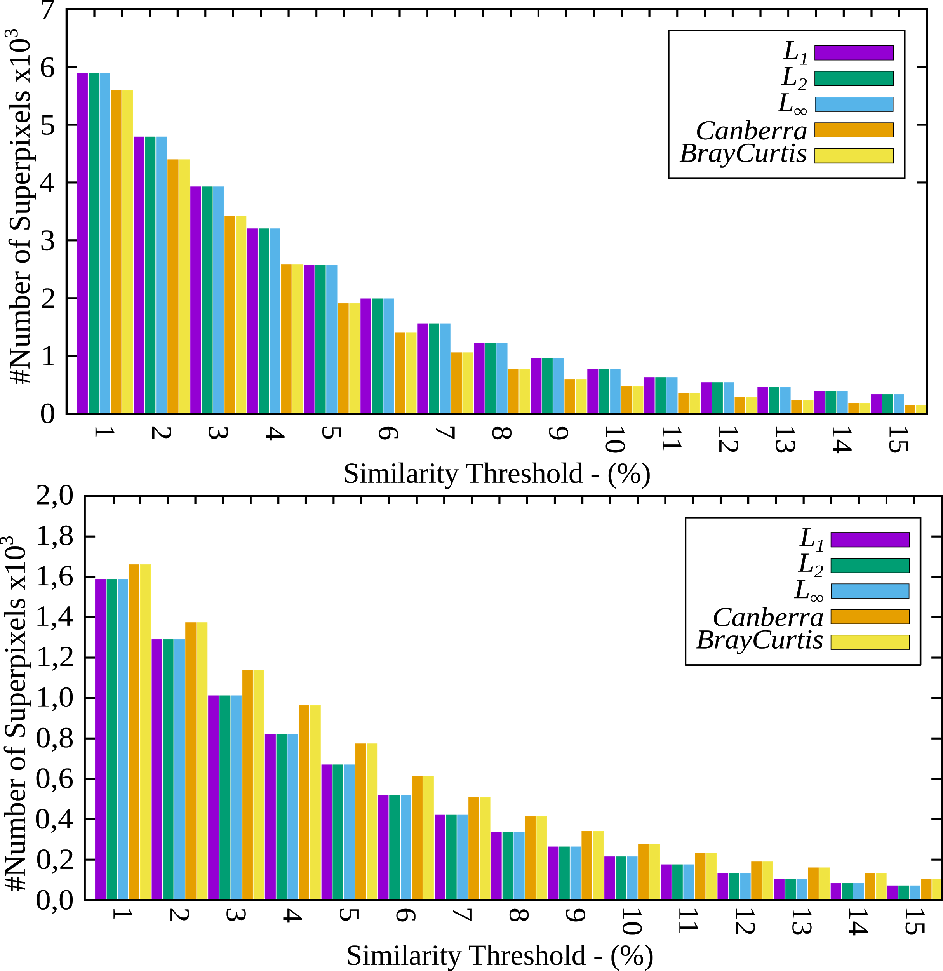
2PLA - 2nd Phase parameterization
Motivation and Background
Proposed Method
Empirical Findings
Future Work
Superpixels of ULCER_SET images
Set as 550 as pointed out by Chino et al. (2018)
ICARUS: Retrieving Skin Ulcer Images through Bag-of-Signatures. In: CBMS, pp. 82-87
Feature Extractor
Average superpixel value in the LAB color space (3 dimensions)
Cluster Method: DBSCAN
Distance functions:
L₁, L₂, L∞, Canberra, and BrayCurtis
Similarity threshold ξ:
A varying percentage of maximum similarity ranging from 0.5% to 15%
40 images
Canberra and BrayCurtis presented a greater variance regarding the number of clusters
Functions L₁, L₂, and L∞ were more stable
On average, Function L₁ produced fewer clusters
A Two-Phase Learning Approach for the Segmentation of Dermatological Wounds

Slide 17
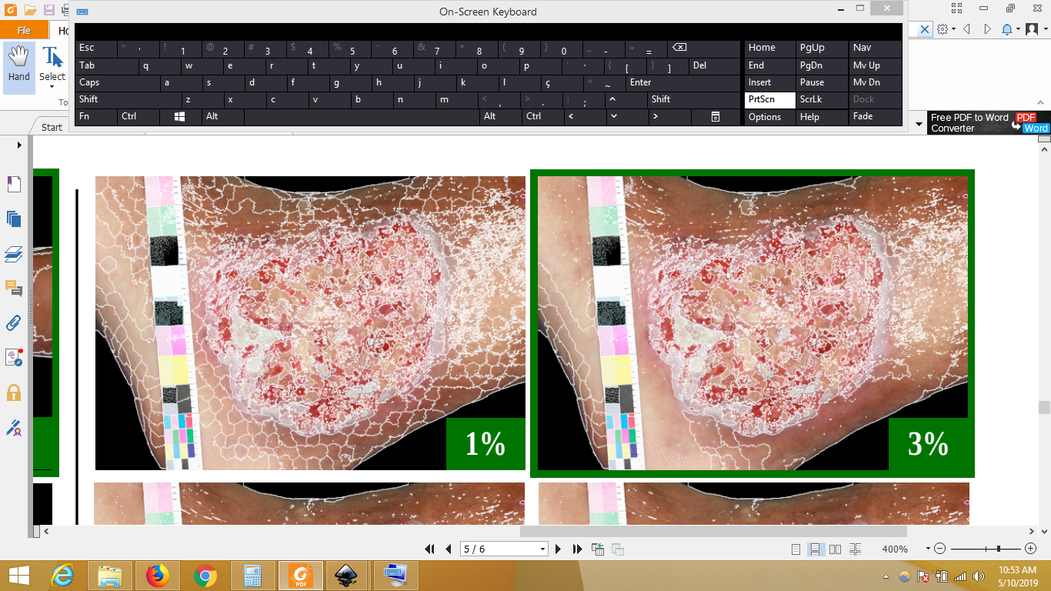
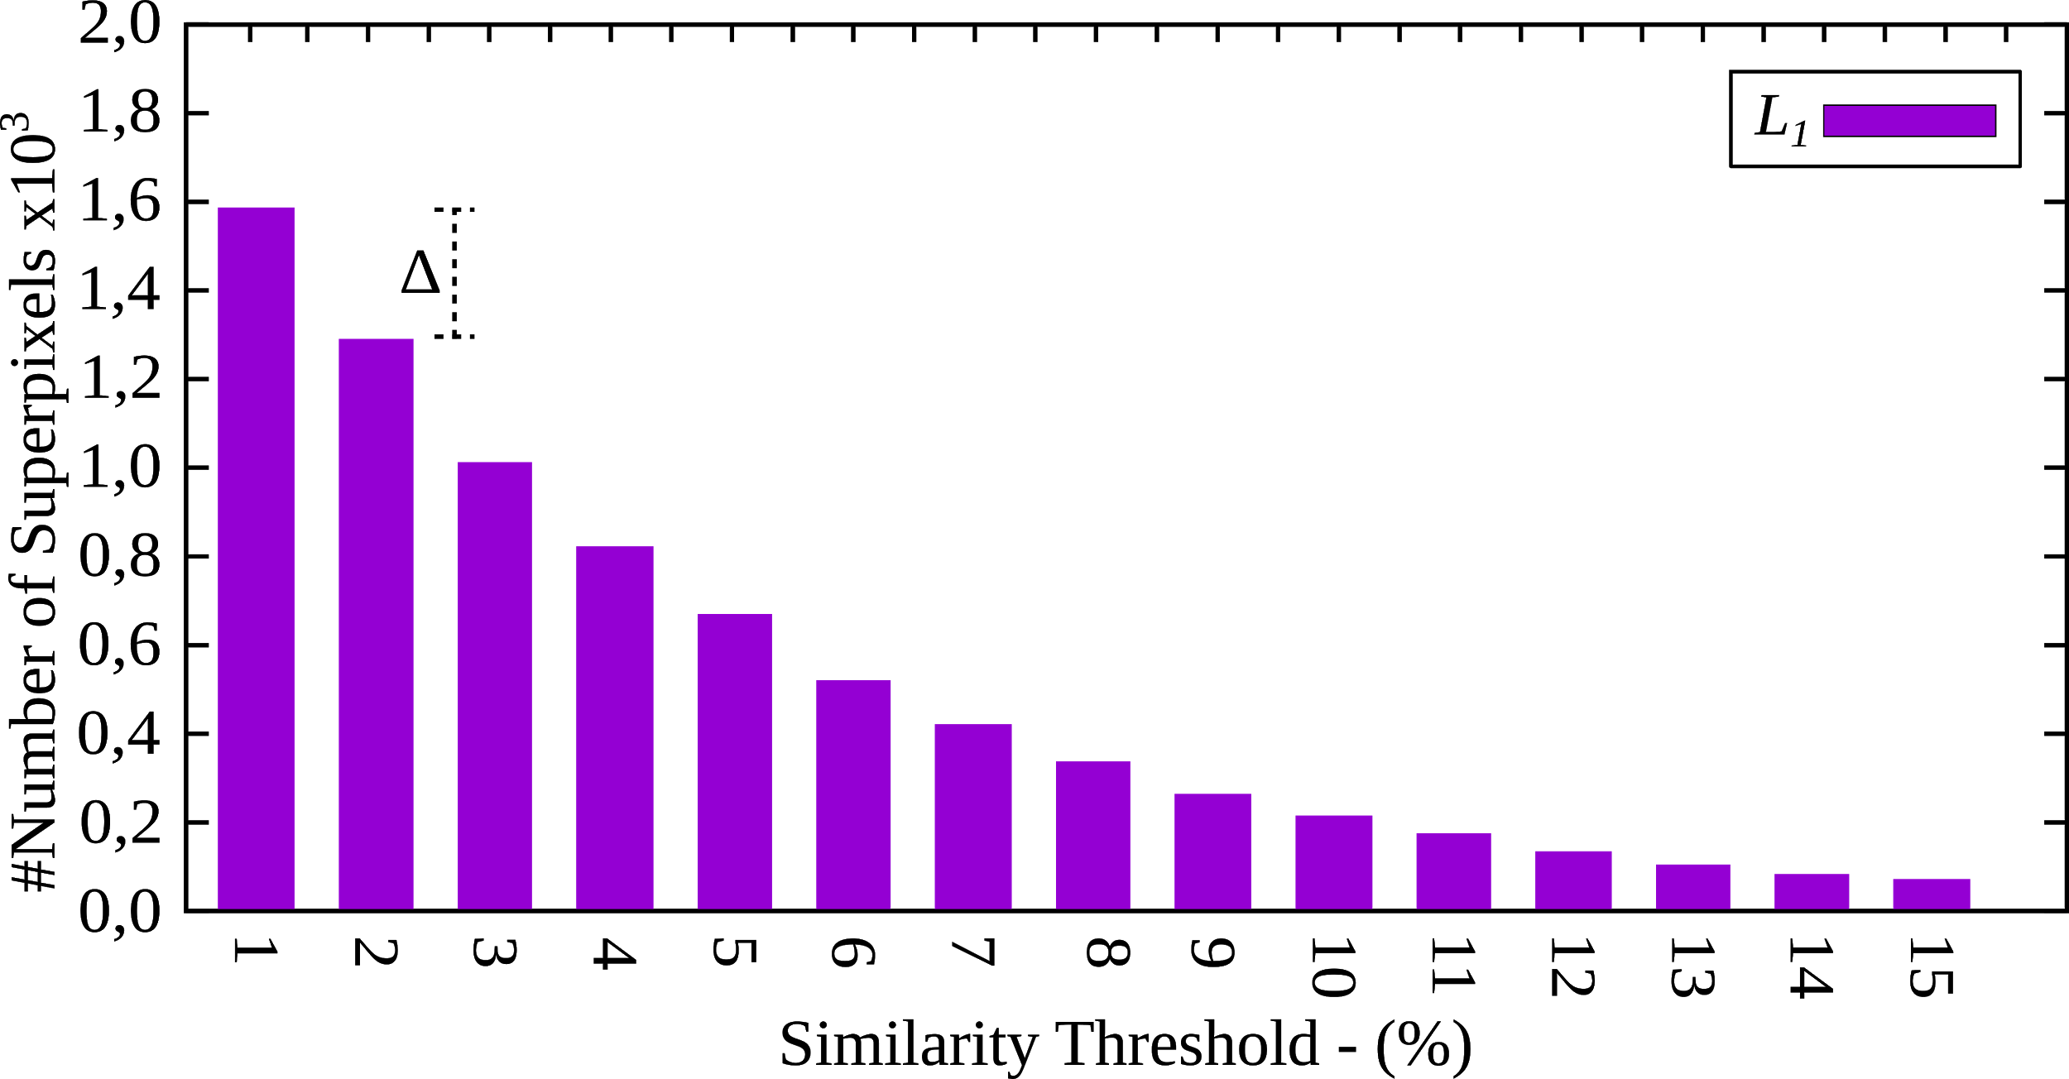
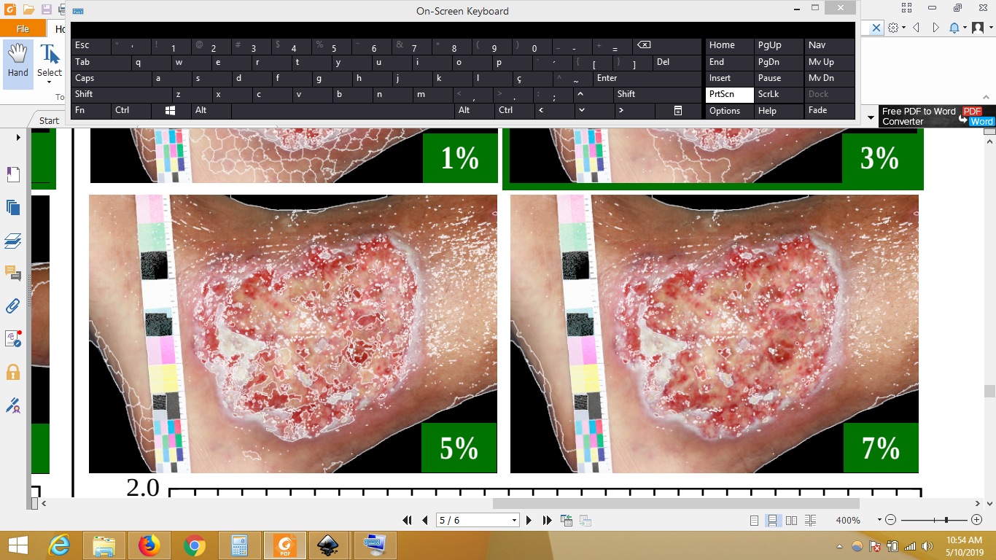
2PLA - 2nd Phase parameterization
Motivation and Background
Proposed Method
Empirical Findings
Future Work
Superpixels of ULCER_SET images
Set as 550 as pointed out by Chino et al. (2018)
ICARUS: Retrieving Skin Ulcer Images through Bag-of-Signatures. In: CBMS, pp. 82-87
Feature Extractor
Average superpixel value in the LAB color space (3 dimensions)
Cluster Method: DBSCAN
Distance functions:
L₁, L₂, L∞, Canberra, and BrayCurtis
Similarity threshold ξ:
A varying percentage of maximum similarity ranging from 0.5% to 15%
Elbow criterion
Cut point determined by the first of two consecutive bars whose difference ratio does not exceed a threshold ∆
Threshold ∆ ranging from 5% to 20%
The most frequent cut was ξ = 3%
40 images
A Two-Phase Learning Approach for the Segmentation of Dermatological Wounds

Slide 18
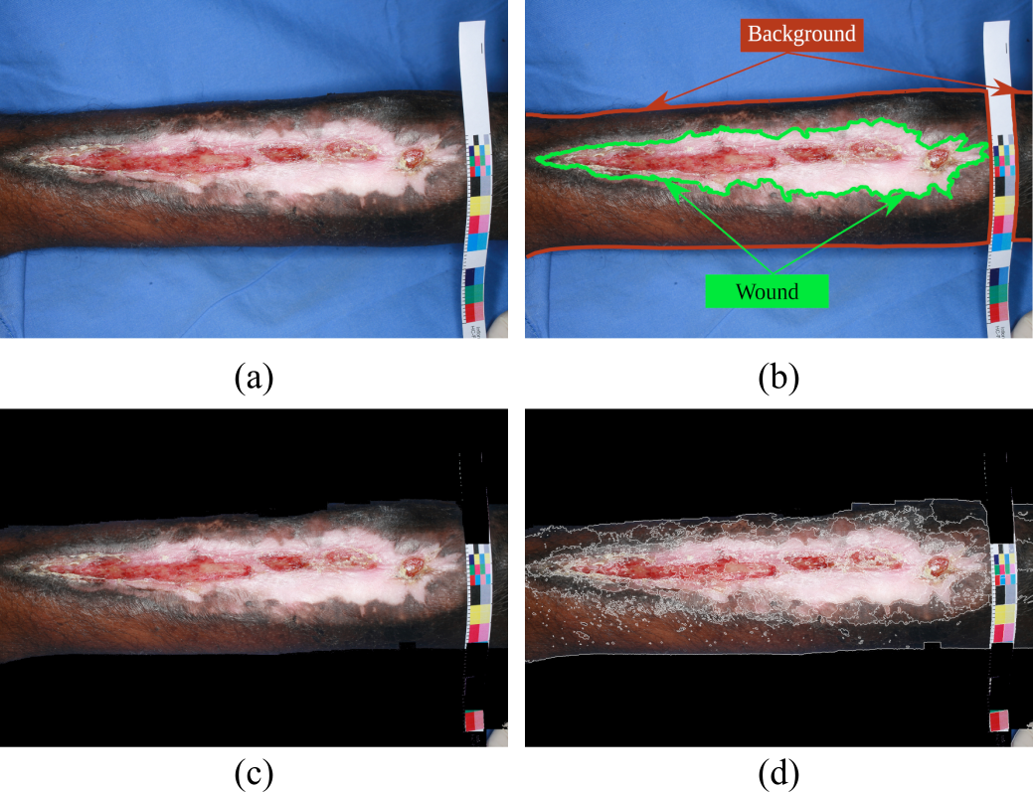
Empirical findings
Motivation and Background
Proposed Method
Empirical Findings
Future Work
04 new ULCER_SET images manually labeled by experts
2PLA Setting
Classifier MLP-LM + 550 Superpixels + Distance function L₁ + Threshold 3%
Mean Absolute Error (MAE)
Pixelwise matching of manual vs. 2PLA segmentation
MAE = 0.05, Variance = 0.01
A Two-Phase Learning Approach for the Segmentation of Dermatological Wounds

Slide 19
Future Work
Motivation and Background
Proposed Method
Empirical Findings
Future Work
Expanding dataset
We are working on expanding ULCER_SET so that it can be used as a benchmark in the near future
Exploring new parameters to 2PLA
Feature extraction
Features learned from autoencoders applied on superpixels
Clustering approaches
Hierarchical clustering methods
Graph-based clustering methods
A Two-Phase Learning Approach for the Segmentation of Dermatological Wounds

Slide 20
Conference
Thanks for your attention!
Student Paper
Research Institutions
A Two-Phase Learning Approach for the Segmentation of Dermatological Wounds
Wellington Silva, Daniel Jasbick, Rodrigo Wilson, Paulo Azevedo-Marques, Agma Traina (speaker), Lucio Santos, Ana Jorge, Daniel de Oliveira, and Marcos Bedo
Institute of Mathematical and Computer Sciences - University of São Paulo
agma@icmc.usp.br
www.gbdi.icmc.usp.br
Funding Agencies
June/2019

Slide 21
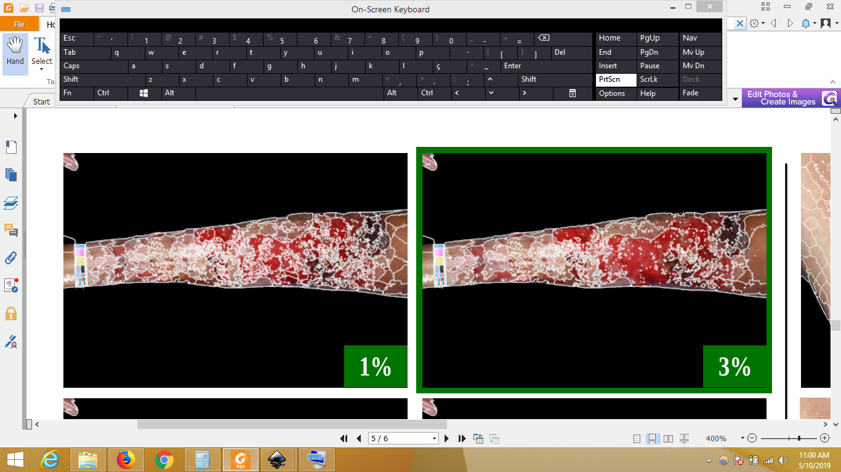
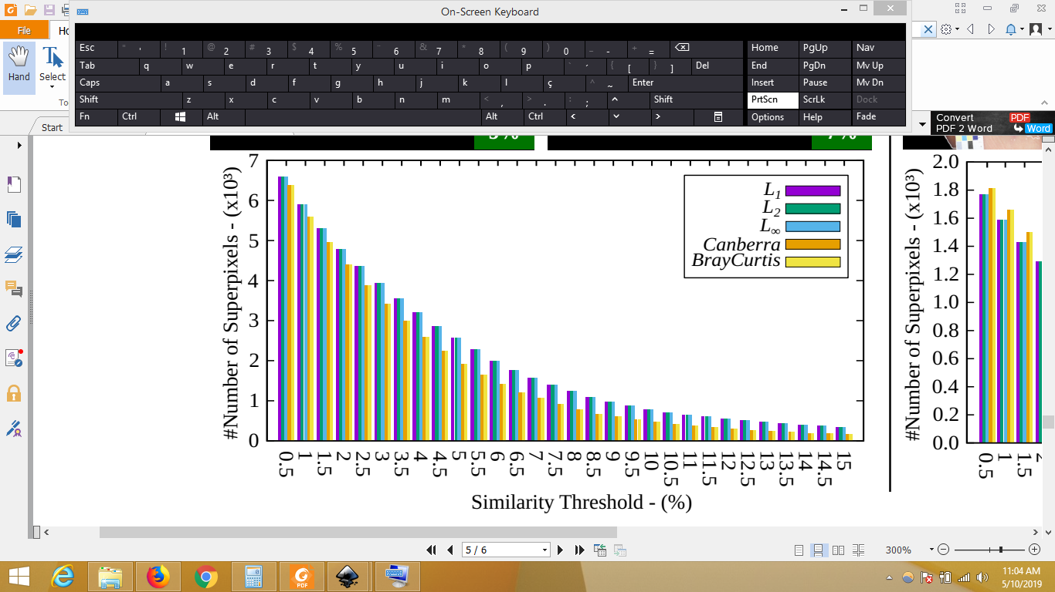
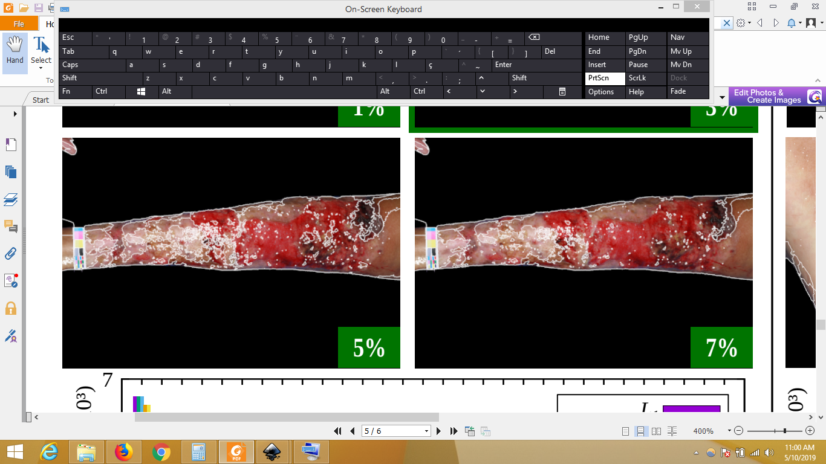
2PLA - DBSCAN parameterization
Conference
Research Institutions
Funding Agencies
June/2019

Slide 22
Motivation
Conference
Research Institutions
Current approaches
Wound segmentation as a classification problem
Tissues of interest vs. non-interest
Building blocks:
Funding Agencies
June/2019

Slide 23
Motivation
Conference
Research Institutions
Current approaches
Wound segmentation as a classification problem
Tissues of interest vs. non-interest
Building blocks: superpixels
Funding Agencies
June/2019

Slide 24
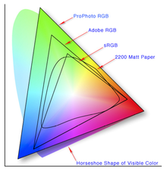
Motivation
Conference
Research Institutions
Current approaches
Wound segmentation as a classification problem
Tissues of interest vs. non-interest
Building blocks: superpixels, feature extractor
Funding Agencies
June/2019

Slide 25
Motivation
Conference
Research Institutions
Current approaches
Wound segmentation as a classification problem
Tissues of interest vs. non-interest
Building blocks: superpixels, feature extractor, training set
Funding Agencies
June/2019

Slide 26
Proposed Method - 2PLA
Conference
Research Institutions
Overall idea = two steps:
Distinguish relevant and non-relevant image regions
Classification-based task (binary problem)
Smooth noise and errors
Agglomerate remaining tissues by their similarity:
Split relevant regions into small pieces with well-defined borders
Represent such pieces as points of a multidimensional space
Calculate the distances between the points as a similarity score
Aggregate the similarities according to a clustering criteria
Result:
Object removal
Wound, border and health tissues segmented
Funding Agencies
June/2019

Slide 27
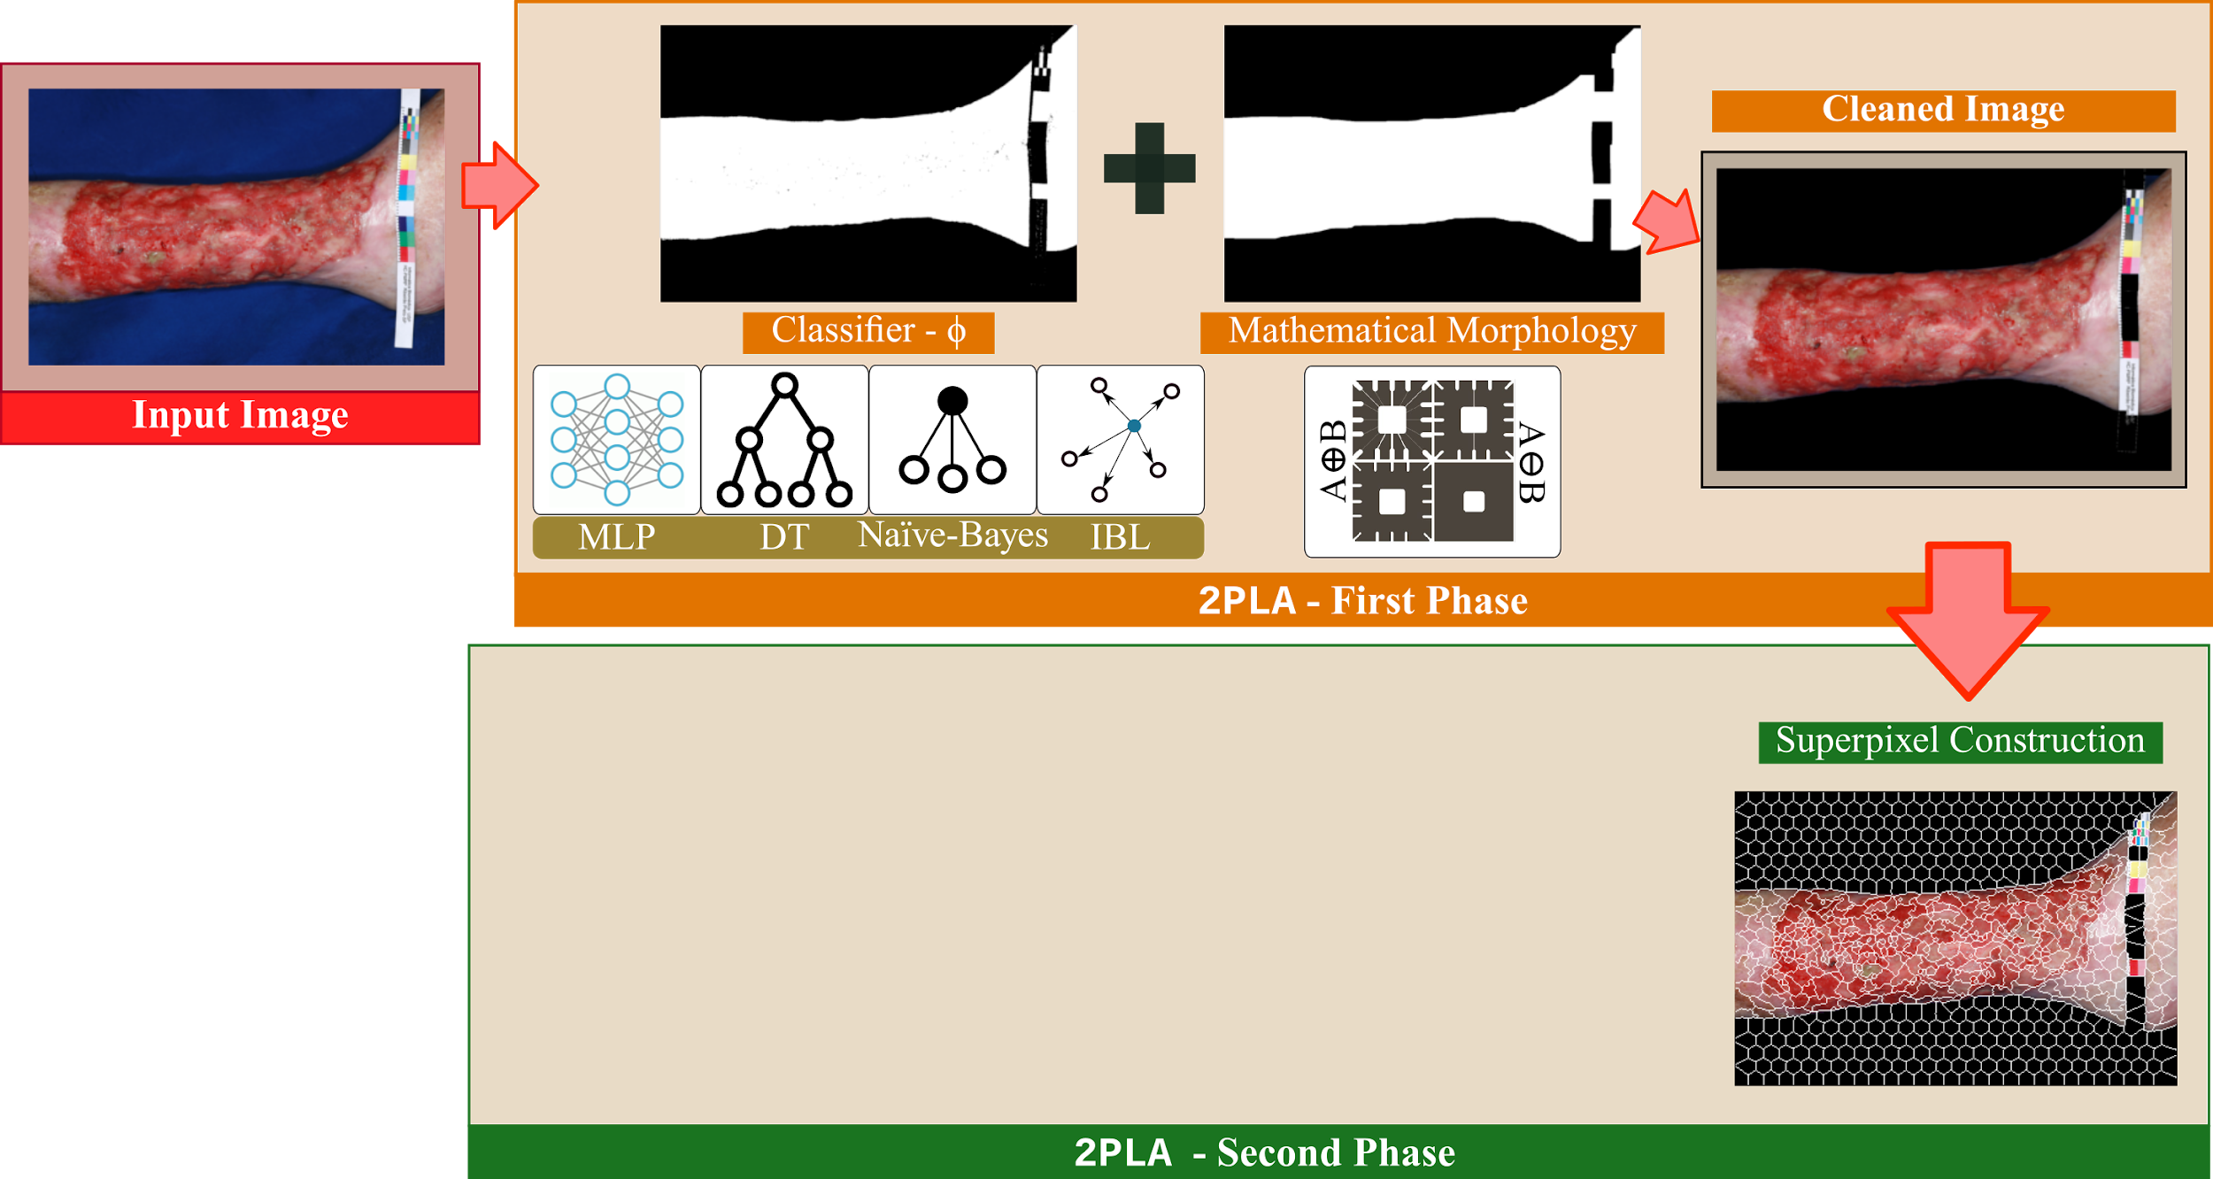
Proposed Method - 2PLA
Conference
Research Institutions
Funding Agencies
June/2019

Slide 28
Questions
Conference
Research Institutions
?
Funding Agencies
June/2019

Slide 29
Summary
Conference
Research Institutions
Motivation and Background
Proposed Method
Empirical Findings
Future Work
Funding Agencies
June/2019

Slide 30
Summary
Conference
Research Institutions
Motivation and Background
Proposed Method
Empirical Findings
Future Work
Funding Agencies
June/2019

Slide 31
Summary
Conference
Research Institutions
Motivation and Background
Proposed Method
Empirical Findings
Future Work
Funding Agencies
June/2019

Slide 32
Summary
Conference
Research Institutions
Motivation and Background
Proposed Method
Empirical Findings
Future Work
Funding Agencies
June/2019

Slide 33
Summary
Conference
Research Institutions
Motivation and Background
Proposed Method
Empirical Findings
Future Work
Funding Agencies
June/2019

Slide 34
Motivation
Conference
Research Institutions
Photographs of ulcers in lower limb
Support dermatologists’ analyses
Tissue characterization
Non-intrusive process
Non-expensive: smartphone-based image recording
Non-expensive: digital photo management
Funding Agencies
June/2019

Slide 35
Motivation
Conference
Research Institutions
Current approaches
Wound segmentation as a classification problem
Tissues of interest vs. non-interest
Building blocks: superpixels, feature extractor, training set, and classifier
Funding Agencies
June/2019

Slide 36
Open Issues...
Conference
Research Institutions
Combination of wound tissues
Border and Reepithelization tissues
Funding Agencies
June/2019

Slide 37
Goals
Conference
Research Institutions
Main Goal:
Designing a divide-and-conquer cluster approach for wound analysis
Processing Challenges
Potential groups
Funding Agencies
Background
removal
Wound “frontiers”
Health tissue
Mix of wound tissues
Border tissue
Reepithelization
Diversified skin colors
June/2019

Slide 38
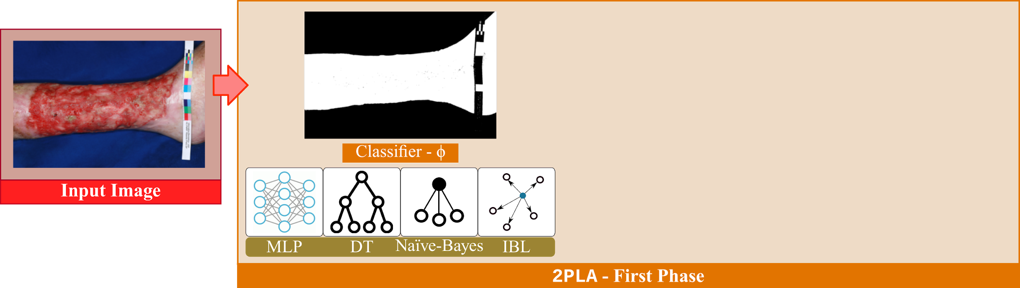
Proposed Method - 2PLA
Conference
Research Institutions
Funding Agencies
June/2019

Slide 39
Proposed Method - 2PLA
Conference
Research Institutions
Funding Agencies
June/2019

Slide 40
Proposed Method - 2PLA
Conference
Research Institutions
Funding Agencies
June/2019

Slide 41
Proposed Method - 2PLA
Conference
Research Institutions
Funding Agencies
June/2019

Slide 42
Dataset - ULCER_SET
Conference
Research Institutions
Curated by Pereira et al. (2013)
Classification of color images of dermatological ulcers. Journal of Biomedicine and Health, 17(1):136–142.
217 photographies of venous and arterial ulcers in lower limbs
Independent patients with different skin colors, age, and treatments
Blue and white cloths were used to emphasize the contrast
Photos were taken with the same camera, angle and distance.
Funding Agencies
June/2019

Slide 43
2PLA - 1st Phase parameterization
Conference
Research Institutions
We asked experts to provide a manual segmentation of 40 representative ULCER_SET images
Result:
Millions of pixels labeled as either “background” or “skin”
Skin pixels form border, granulation, fibrin, and necrosis areas.
Training set:
Stratified sampling of labeled pixels in the RGB color space
Varying sizes: 1.10¹, 1.10², 1.10³, 1.10⁴, and 1.10⁵
Fed to 10-folds cross-validation routines
Funding Agencies
June/2019

Slide 44
2PLA - 1st Phase parameterization
Conference
Research Institutions
We asked experts to provide a manual segmentation of 40 representative ULCER_SET images
Result:
Millions of pixels labeled as either “background” or “skin”
Skin pixels form border, granulation, fibrin, and necrosis areas.
Funding Agencies
Sampling 1.10.³
Sampling 1.10.⁴
Sampling 1.10.⁵
June/2019

Slide 45
2PLA - 1st Phase parameterization
Conference
Research Institutions
Finding the most suitable classifier
Training set sizes: 1.10¹, 1.10², 1.10³, 1.10⁴, and 1.10⁵
Average Cohen-Kappa Coefficient
Weighted Mean
Funding Agencies
Simple Mean
June/2019

Slide 46
Discarding of Superpixels
Conference
Research Institutions
Background removal - 40 images
Mean and deviation for the proportion of discarded regions
Discarding ratio grew linearly
Up to 48% dismissed regions
Funding Agencies
June/2019

Slide 47
2PLA - 2nd Phase parameterization
Conference
Research Institutions
Superpixels of ULCER_SET images
Set as 550 as pointed out by Chino et al. (2018)
ICARUS: Retrieving Skin Ulcer Images through Bag-of-Signatures. In: CBMS, pp. 82-87
Feature Extractor
Average superpixel value in the LAB color space (3 dimensions)
Cluster Method: DBSCAN
Distance functions:
L₁, L₂, L∞, Canberra, and BrayCurtis
Similarity threshold ξ:
A varying percentage of maximum similarity ranging from 0.5% to 15%
Funding Agencies
June/2019

Slide 48
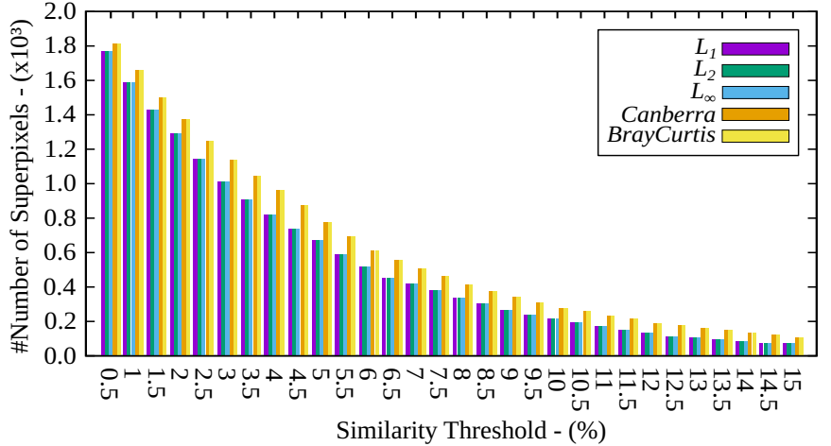
2PLA - DBSCAN parameterization
Conference
Research Institutions
Funding Agencies
June/2019

Slide 49
2PLA - 2nd Phase parameterization
Conference
Research Institutions
40 images
Canberra and BrayCurtis presented a wider variance regarding the number of clusters
Functions L₁, L₂, and L∞ were more stable
Function L₁ generated fewer clusters in comparison to others, on average
Funding Agencies
June/2019

Slide 50
2PLA - 2nd Phase parameterization
Conference
Research Institutions
40 images
Elbow criterion of Scree-Plot
Cut point determined by the first of two consecutive bars whose difference ratio does not exceed a threshold ∆
Experiments with ∆ ranging from 5% to 20%
The most frequent cut point was ξ = 3%
Funding Agencies
June/2019

Slide 51
Empirical findings
Conference
Research Institutions
04 new ULCER_SET images
Manually labeled by experts
Pixelwise matching of manual vs. 2PLA segmentation
2PLA Setting
Classifier MLP-LM
SLIC Superpixels
Distance function L₁
Similarity threshold 3%
Mean Absolute Error (MAE)
Average absolute differences between two labeling tasks
Funding Agencies
June/2019

Slide 52
Empirical findings
Conference
Research Institutions
04 new ULCER_SET images
Manually labeled by experts
Pixelwise matching of manual vs. 2PLA segmentation
2PLA Setting
Classifier MLP-LM
SLIC Superpixels
Distance function L₁
Similarity threshold 3%
Funding Agencies
MAE = 0.05 - Variance = 0.01
June/2019

Slide 53
Future Work
Conference
Research Institutions
Expanding dataset
We are working on expanding ULCER_SET so that it can be used as a benchmark in the near future
Exploring new parameters to 2PLA
Feature extraction
Features learned from autoencoders applied on superpixels
Clustering approaches
Hierarchical clustering methods
Graph-based clustering methods
Funding Agencies
June/2019

Slide 54
Proposed Method - 2PLA
Motivation and Background
Proposed Method
Empirical Findings
Future Work
A Two-Phase Learning Approach for the Segmentation of Dermatological Wounds

Slide 55
2PLA - 2nd Phase parameterization
Motivation and Background
Proposed Method
Empirical Findings
Future Work
Superpixels of ULCER_SET images
Set as 550 as pointed out by Chino et al. (2018)
ICARUS: Retrieving Skin Ulcer Images through Bag-of-Signatures. In: CBMS, pp. 82-87
Feature Extractor
Average superpixel value in the LAB color space (3 dimensions)
Cluster Method: DBSCAN
Distance functions:
L₁, L₂, L∞, Canberra, and BrayCurtis
Similarity threshold ξ:
A varying percentage of maximum similarity ranging from 0.5% to 15%
40 images
Canberra and BrayCurtis presented a greater variance regarding the number of clusters
Functions L₁, L₂, and L∞ were more stable
On average, Function L₁ produced fewer clusters
Elbow criterion of Scree-Plot
Cut point determined by the first of two consecutive bars whose difference ratio does not exceed a threshold ∆
Experiments with ∆ ranging from 5% to 20%
The most frequent cut point was ξ = 3%
A Two-Phase Learning Approach for the Segmentation of Dermatological Wounds

Slide 56
2PLA - 2nd Phase parameterization
Motivation and Background
Proposed Method
Empirical Findings
Future Work
Superpixels of ULCER_SET images
Set as 550 as pointed out by Chino et al. (2018)
ICARUS: Retrieving Skin Ulcer Images through Bag-of-Signatures. In: CBMS, pp. 82-87
Feature Extractor
Average superpixel value in the LAB color space (3 dimensions)
Cluster Method: DBSCAN
Distance functions:
L₁, L₂, L∞, Canberra, and BrayCurtis
Similarity threshold ξ:
A varying percentage of maximum similarity ranging from 0.5% to 15%
40 images
Canberra and BrayCurtis presented a greater variance regarding the number of clusters
Functions L₁, L₂, and L∞ were more stable
On average, Function L₁ produced fewer clusters
A Two-Phase Learning Approach for the Segmentation of Dermatological Wounds

